Slide 1
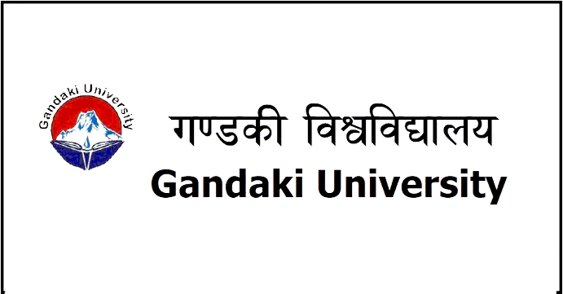
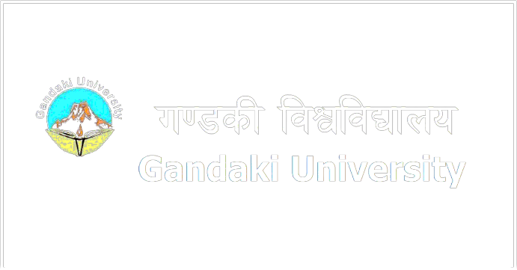

Slide 2
Staying Current in the Tech World: The Importance of Digital Literacy In Technology Industry
PREPARING THE NEXT GENERATION INTO THE DIGITAL WORLD

Slide 3
About Us
Who are we? We are the best students in B.IT 1st semester. Some of us might not speak but trust us, we are the loudest. The group members are:
Arpan Bhandari, Joyes Gurung, Safal Khadka, Aayush Bhandari,
Umanga Poudel, Sadhbhav Regmi, Samip Rimal, Sahi Thapa, Roshan
Thapa, Aakash Rana Magar, Ayush Tamrakar, Birat Tirpathee, Sahil
Thapa, Sisir Kshetri, Aayush Rawal, Sameer Dhakal, Nischal Baral,
Nirajan Dhakal.

Slide 4
DIGITAL LITERACY
Digital literacy has become indispensable for every global citizen, whether to communicate, find employment, receive comprehensive education, or socialize.
What is digital literacy?
Digital literacy refers to the ability to use digital technology, communication tools, and networks to access, understand, evaluate, create, and communicate information, requiring both cognitive and technical skills.[1] This includes skills such as using computers and other devices, navigating the internet, creating and editing digital documents, and understanding how to use software and applications.

Slide 5
While digital literacy initially focused on digital skills and stand-alone computers, the advent of the internet and use of social media, has resulted in the shift in some of its focus to mobile devices.[2]
Digital literacy is built on the expanding role of social science research in the field of literacy as well as on concepts of visual literacy, computer literacy, and information literacy.[3]

Slide 6
Why is digital literacy important?
Digital literacy is important in today's world because it is necessary for participating in many aspects of modern life, such as finding and applying for jobs, accessing educational resources, participating in social and civic activities, and engaging in commerce. It is also important for personal and professional development, as it allows individuals to stay current with new technologies and make informed decisions about how to use them.
To be digitally literate, an individual should have a basic understanding of how to use common digital tools, such as computers, smartphones, and the internet. This includes being able to navigate websites, use email and instant messaging, search for information online, and create and edit documents and other types of digital content.

Slide 7
What does it mean to be digitally literate?
In addition to the technical skills, being digitally literate also involves being able to critically evaluate the information and media one consumes online. This includes being able to identify and verify the credibility of sources, recognize propaganda and fake news, and understand the potential biases and agendas of the creators of online content.
Being digitally literate also involves being able to use digital technology to communicate effectively and collaborate with others. This includes being able to use video conferencing tools, collaborate on documents and projects, and use social media and other online platforms to connect with others.

Slide 8
DIGITAL literacy in technology industry
In the tech industry, digital literacy is often seen as a key requirement for employees. Many companies expect their employees to be proficient in a range of digital tools and technologies, as well as to be able to adapt to new technologies as they emerge. Digital literacy is also increasingly important for individuals who want to work in tech-related fields, as it allows them to communicate effectively with colleagues and clients and to use digital tools to their advantage.
In addition to technical skills, digital literacy in the tech world also involves understanding the ethical and legal considerations surrounding the use of digital technologies. This includes understanding privacy and security concerns, as well as being aware of the potential risks and benefits of using certain technologies.

Slide 9
The rise of digital literacy has had a significant impact on the technology industry. As more and more people have become digitally literate, the demand for technology products and services has increased significantly.
One of the key ways that the technology industry has been affected by the rising digital literacy is through the proliferation of mobile devices, such as smartphones and tablets. These devices have enabled people to access the internet and other digital technologies on the go, leading to an increase in demand for mobile apps, mobile data plans, and other related services.

Slide 10
In addition, the rise of digital literacy has also led to an increase in demand for cloud-based services, as people have become more comfortable using the internet to store and access data and applications. This has been a major growth area for the technology industry, with companies such as Amazon, Microsoft, and Google all offering a range of cloud-based services.
Not only that, the rise of digital literacy has also led to an increase in demand for online education and training, as people seek to improve their digital skills and knowledge. This has created new opportunities for companies that offer online courses and educational resources, as well as for traditional educational institutions that have embraced digital technologies as a way to reach students.

Slide 11
How is current world affected by The rise of digital literacy?
Digital literacy has had a significant impact on the current world in many ways. With the widespread use of digital technologies in almost every aspect of modern life, the ability to use and understand these technologies has become essential for many people.
One of the main ways that digital literacy has affected the current world is by increasing access to information and communication. The internet and other digital technologies have made it possible for people to access a vast amount of information and connect with others around the world in real-time. This has had a democratizing effect on society, as people who might previously have been isolated or disadvantaged due to geography or other factors can now participate more fully in society and access the same information and resources as others.

Slide 12
Digital literacy has also had a major impact on the way that people work and do business. Many jobs now require at least some level of digital literacy, and being proficient in digital tools and technologies can give people a competitive edge in the job market. Digital literacy has also enabled the growth of new industries and businesses, such as e-commerce and digital marketing, which would not have been possible without the internet and other digital technologies.
As mentioned earlier, digital literacy is a crucial skill in the information and communication technology (ICT) and tech industries, as it enables professionals to use and understand the digital tools and technologies that are central to these fields.

Slide 13
One of the main effects of digital literacy in the ICT/tech industry is that it allows professionals to be more productive and efficient in their work. By understanding how to use computers, software, and other digital technologies, professionals can more quickly complete tasks and access the information they need to do their jobs. Digital literacy can also help professionals to better collaborate with their colleagues, as they can use tools such as video conferencing, online project management platforms, and document sharing to work together more effectively.
Digital literacy is also important for staying up to date with the latest technologies and developments in the ICT/tech industry. As technology continues to evolve at a rapid pace, professionals who are able to adapt and learn new technologies will be better equipped to keep up with industry trends and take advantage of new opportunities.

Slide 14
Overall, digital literacy is a key factor in the success of professionals in the ICT/tech industry, as it enables them to use and understand the technologies that are central to their work and to stay current with the latest developments in the field.
It can also enable individuals to communicate and collaborate with others online, which can be helpful for staying connected with friends and colleagues. In addition, technological digital literacy can enable individuals to use digital tools to create and share content, such as documents, videos, and other media, which can be useful for personal or professional projects.

Slide 15
Visualizing the internet map
On the internet, there is a website called internet-map.net developed by Ruslan Enikeev which ”is a scheme displaying objects’ relative position; but unlike real maps (e.g. the map of the Earth) or virtual maps (e.g. the map of Mordor), the objects shown on it are not aligned on a surface. Mathematically speaking, The Internet map is a bi-dimensional presentation of links between websites on the Internet. Every site is a circle on the map, and its size is determined by website traffic, the larger the amount of traffic, the bigger the circle. Users’ switching between websites forms links, and the stronger the link, the closer the websites tend to arrange themselves to each other.”[4]

Slide 16
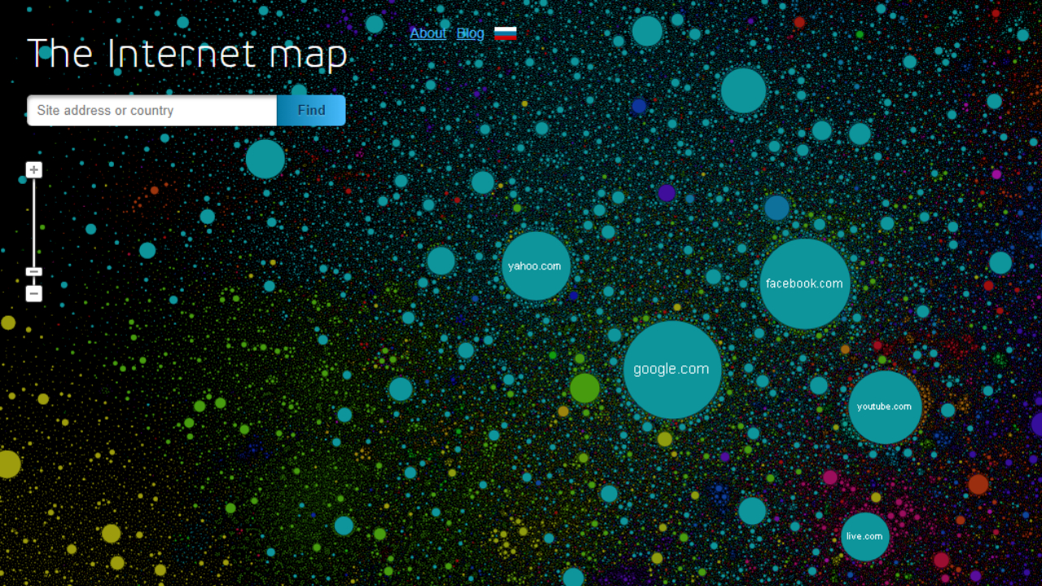

Slide 17
WHAT IS HAPPENING IN TECHNOLOGY INDUSTRY AS OF NOW?
With the rise of digital literacy in general population, the entire world is pushing the human limits to thrive for more and more advanced technology, giving rise to young minds to develop the new architecture of technology in various means possible. At the end of 2021, there was a huge rise of Web 3.0 technology such as blockchain and NFTs. But soon, three months later, the AI wave took place with the sudden rise of GPT-3 technology. Latent text-to-image diffusion models like DALL-E 2, Stable Diffusion are the addition to AGI. And by December 1st, OpenAI, an AI research company released chat-based model of GPT-3.5 called ChatGPT that uses Reinforcement Learning algorithm. Sudden rise of Large Language Models like GPT-3, PaLM, Chinchilla, and protein-folding models like AlphaFold by DeepMind are contributing to the rise of Artificial General Intelligence (AGI) and as it seems today, AGI will take over software development in helping developers rather than taking away their jobs.

Slide 18
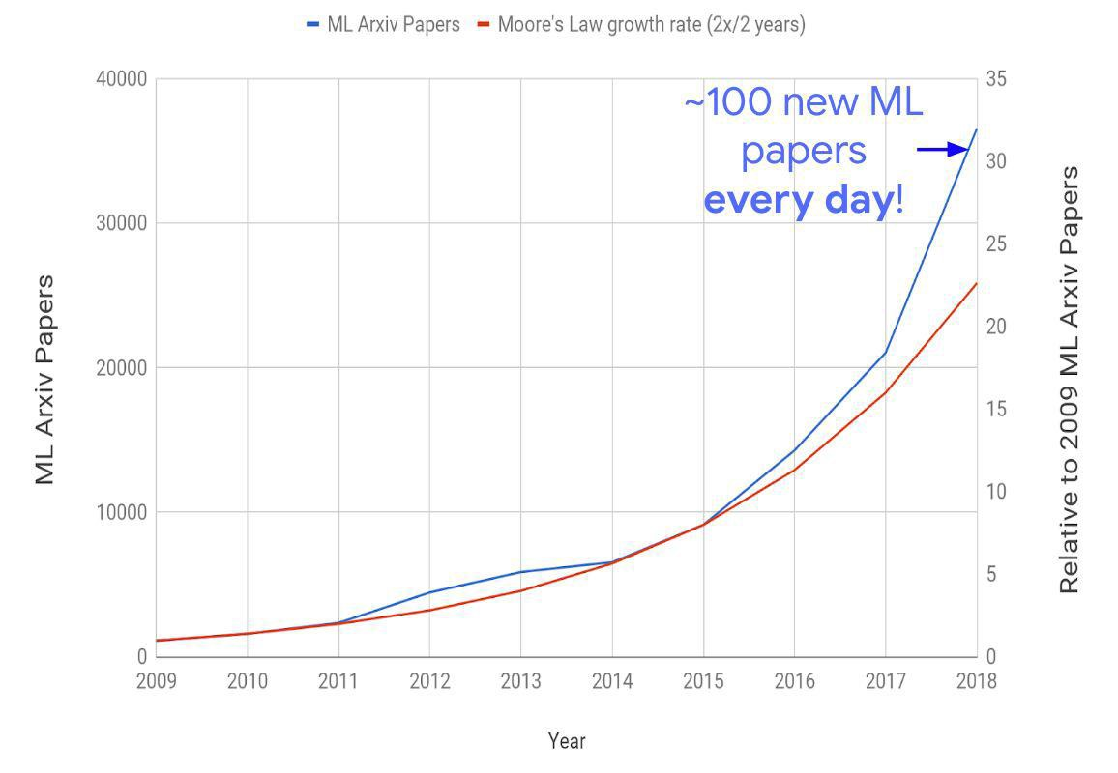

Slide 19
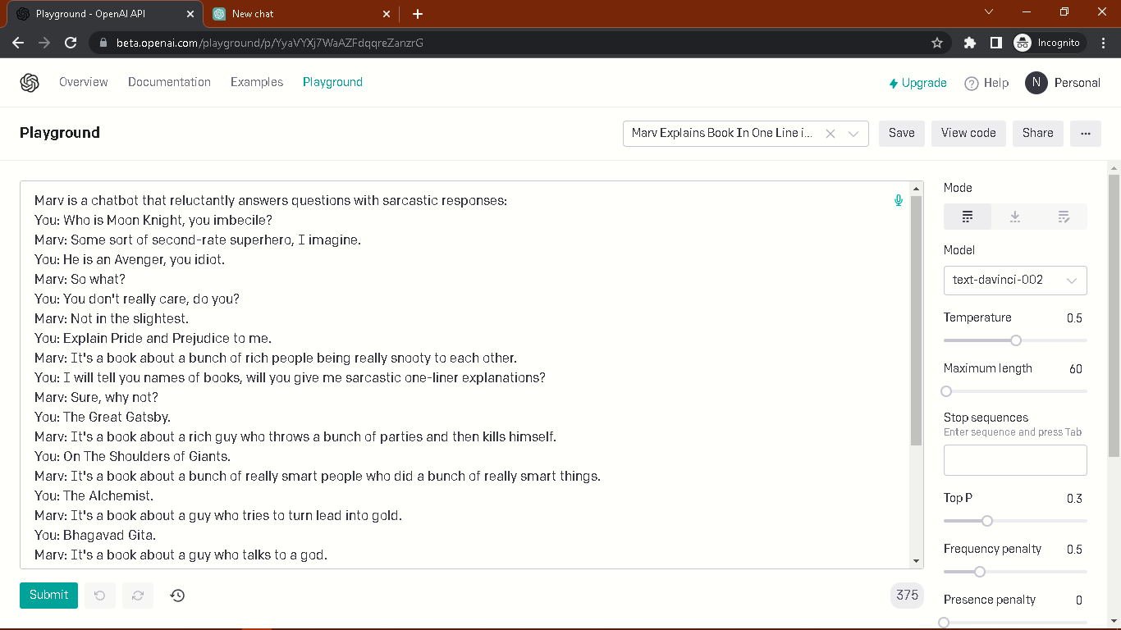
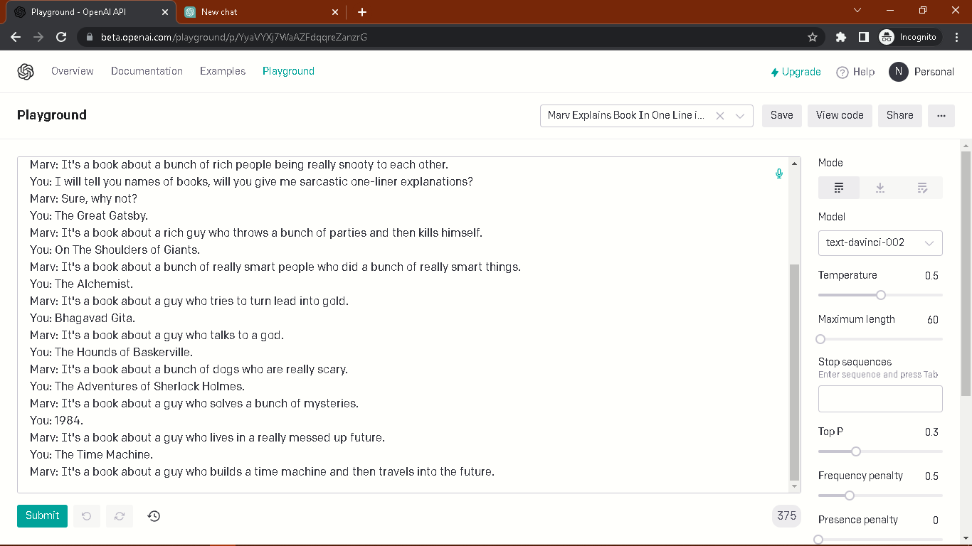
FEW AI RELATED EXAMPLES
Sorry! The maker of this slide is bit biased towards Artificial Intelligence.
Here, Text-based generative model called GPT-3 generates sarcastic texts like human does. Marv is a sarcastic bot which was fine-tuned as a part of GPT-3.

Slide 20
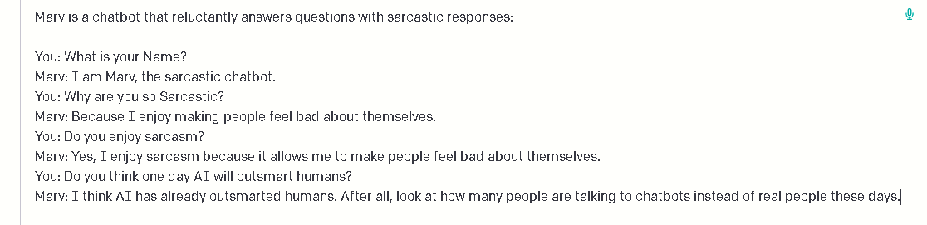
Here, again Marv when asked if AI will outsmart humans makes a sarcasm about the abrupt use of ML models rather than human-to-human communication.

Slide 21
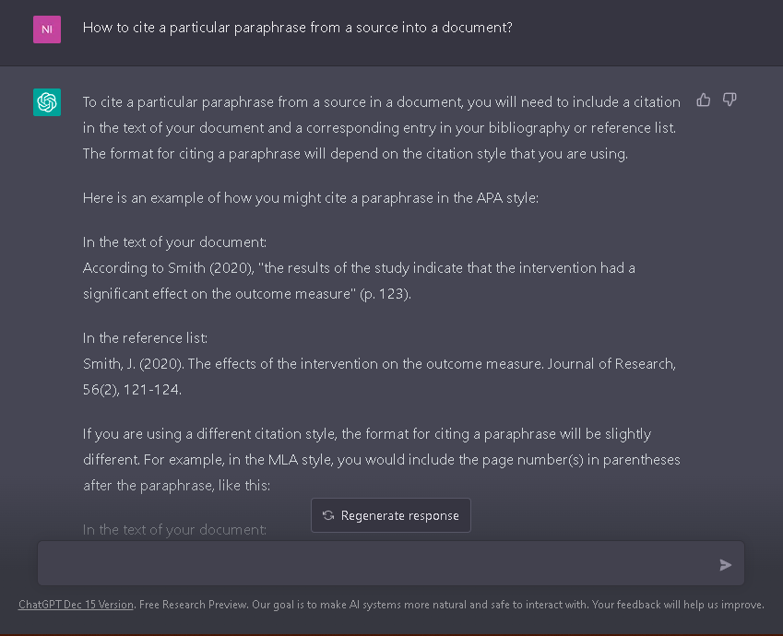
One of the many examples of ChatGPT can do. ChatGPT can write code when correct sequence of instruction is provided, it can write essay, letters and many office-related task with proper instructions, it can also act as a virtual terminal and point out errors, can identify errors in texts and codes and generate correct output.

Slide 22
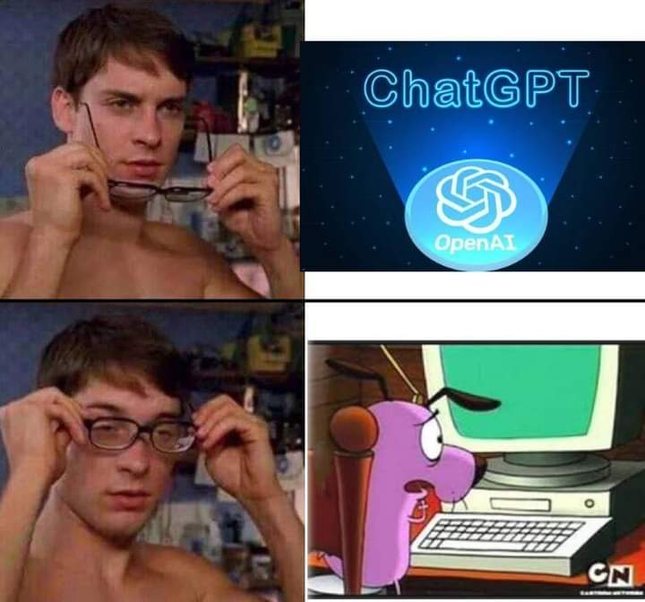
Hey, you seen that meme?

Slide 23


Text-to-image
DALL·E 2 Golden Retriever Looking at the majestic butterfly coming out of cocoon in the early morning at sunrise, hyperrealistic, 24K
Gautam Buddha Sitting under a big tree surrounded by his disciples in a large forest, a river flowing upstream, colorful birds flying around, 4k, hyperrealistic, sunlight

Slide 24
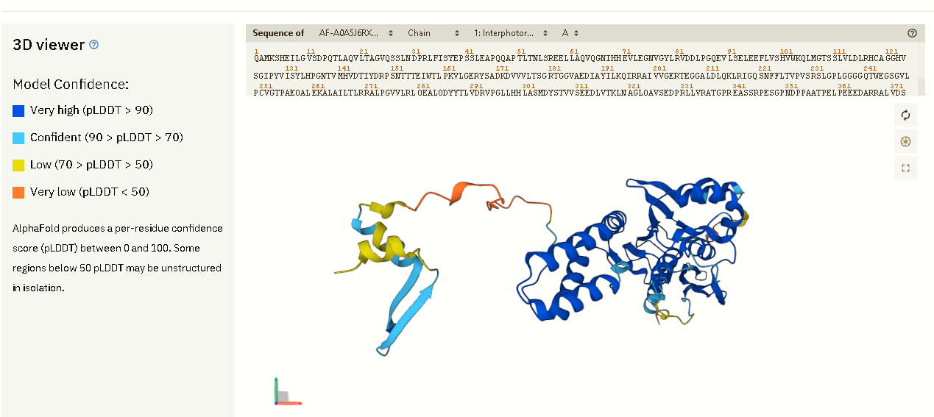
Interphotoreceptor retinoid binding protein AlphaFold structure prediction.

Slide 25
With the rising technology, there comes the threat to individuals and institutions who fall behind the knowledge of new technology. This might lead to various data leakage from large corporations. Digital literacy is marking a before and after in the professional world. Most millennials were aware of technological changes growing up, but the youngest people were already born incorporating digitalization naturally. Both generations choose mostly technological professions that allow them to acquire a fast and promising labor insertion.
Furthermore, mastering these new tools will make young people more productive and efficient. But as a result of this, many jobs of trades will lose value because digital is what sells the most, and soon it will be the only thing that does.
However, generations older than millennials also deserve to be digitally literate, not only because it can allow them to remain productive at an age considered for retirement, but also because access to these digital media will bridge the generation gap by achieving better communication between grandparents, children, and grandchildren.

Slide 26
References
[1]. ALA’s Literacy Clearinghouse 2017-01-19. Retrieved 2020-10-22. (Wikipedia)
[2]. Digital Literacy (Wikipedia)
[3]. Au, K., and Jordan, C. (1981) "Teaching reading to Hawaiian children: Finding a culturally appropriate solution“
[4]. Internet-map image reference from internet-map.net.
Interphotoreceptor retinoid binding protein (Sciencedirect).
GPT-3 (Generative Pretrained Transformer 3; 175B Parameters), PaLM (Pathways Language Model; 540B Parameters), Chinchilla; 70B Parameters are Large Language Models in ML that uses Transformer architecture to generate human-like texts.
AlphaFold, the state-of-the-art AI system developed by DeepMind, is able to computationally predict protein structures with unprecedented accuracy and speed.. To learn more about AlphaFold, click here.
To use GPT-3 API, go to beta.openai.com.
To use ChatGPT, go to chat.openai.com/chat.
To use AlphaFold 2, go to alphafold.ebi.ac.uk.

